Slide 1


Business Data Management Capstone Project
Precision Enhancement of Customer Care Workflow in Pharmaceutical Setting & Leveraging Data-Driven Strategies.
Name : DHULIPALLA UMESH MANIKANTA
Roll. No : 23f2001471
Email : 23f2001471@ds.study.iitm.ac.in

Slide 2

Contents
1. Overview of the Business
2. Metadata of the collected data
3. Statistics and Analysis of the data
4. Findings Insights and Recommendations

Slide 3


Overview of Business
Brief about the Business
I elected to collect the data from LAXMI GENERIC PHARMACY, located in Guntur, Andhra Pradesh. The store was started by Mr. Balu in the year 2019 with initial investment of 10 Lakhs. Over time business started expanding its wings by opening new branches. Currently the business is running with 4 main branches and nearly 10 employees.
Overview of Problems Faced by the Business:
Inventory mismanagement, losses from expired medicines, cash flow blockage, uneven branch performance, and a shift from B2C to B2B are key issues. The focus is on enhancing sales and expanding business reach.

Slide 4

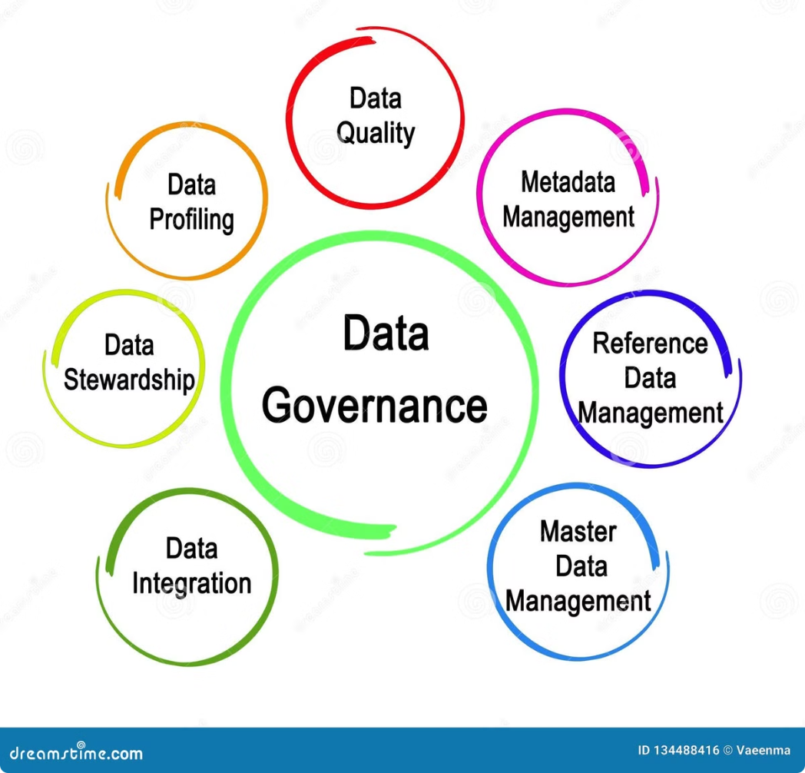
Metadata & Analysis of collected data
Data Collection
Data Cleaning
The data provided by the business is having sales, purchase and stock information of 9 months which is from June 2023 to Feb 2024.
The data obtained from the business is having some unwanted data which is not relevant for our analysis, such data is removed and formatting of each data columns with its appropriate datatype for better analysis.
The data is provided in excel sheets separately for sales, purchase and Stock maintenance of the month.

Slide 5
Statistics and analysis of the data
1
Profit Generated
The amount of profit generated in 9 months through sales is ₹95239.12 and the the loss due to expired medicines is ₹8197.2 , the overall profit is ₹87,041.92
Assuming the same sale trend we can state that the business is having a profit of 1.3 - 1.4 Lakhs per annum.
2
Revenue
Revenue generated by the business with in the period of 9 months is ₹49,87,750.94
Assuming the same sale trend we can state that the business is having a revenue of 66-67 Lakhs per annum.
3
Branch analysis
Out of 4 Branches Laxmi Generic Pharmacy- B1 is performing well, the remaining 3 branches are performing equally.

Slide 6
Tools Used
Excel
Python
Tableau
For basic operations like removing unwanted data, formatting columns, Pivot tables, basic visualizations.
For Advanced visualizations and construction of heatmaps for identifying correlations.
For creating advanced visualizations and for constructing dashboards of sales and purchase data.

Slide 7
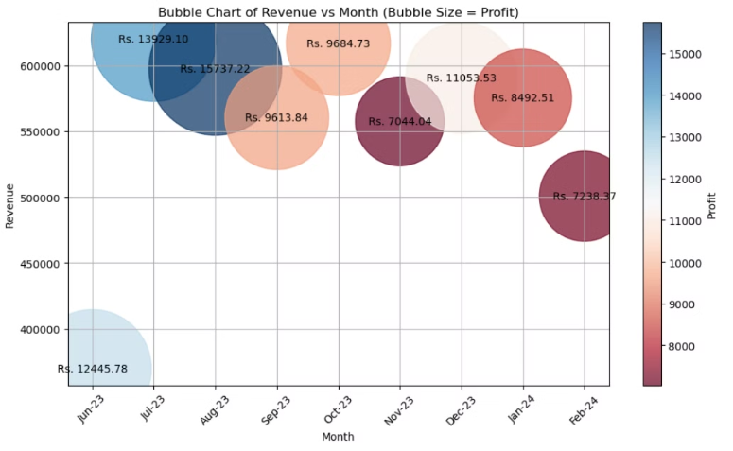
Data Insights and Findings
From the chart we can infer the August is the month where the business experienced maximum in the given 9 months. And November is the month where the business had low profits.
Low revenue is generated in the months June -2023 and Feb 2024.Except these 2 remaining are having similar revenue.

Slide 8
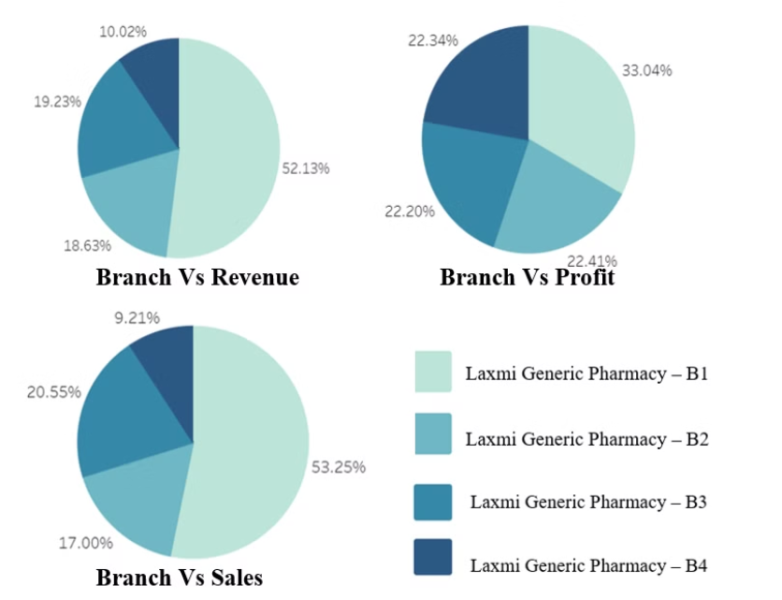
Contd..
B1 is contributing the highest share of the profit, revenue and sales. The remaining 3 branches are contributing almost the same share of the profit, revenue and Sales.
Though there is only 11% difference between branch B1 and remaining branches in terms of profit but there is huge difference which is 35% in terms of revenue and Sales.
Maintaining the performance of B1, and concentrating on improvement of sales in remaining 3 branches will help in increasing profits.

Slide 9

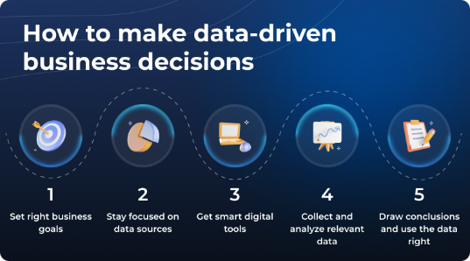
Conclusion and Next Steps
Effective data management is critical for driving business success in today's data-driven world.
By embracing key principles, implementing sound strategies, and addressing challenges proactively, organizations can unlock the full potential of their data.

Slide 10

Appreciation and Gratitude
Thank you for exploring our Business Data Management Capstone Project. Your interest and support mean a lot to us. We are grateful for the opportunity to share our insights and experiences with you.

